Slide 1


Assumptions of physics: project overview
Gabriele Carcassi

Slide 2
Assumptions of Physics
This is an overview of the Assumptions of Physics project (see https://assumptionsofphysics.org/)
The aim of the project is to find a handful of physical principles and assumptions from which the basic laws of physics can be derived

Slide 3
Typical view in the foundations of physics
Start with the theory that describes “what really happens”
With the most complicated and most complete description
Gradually derive other theories as approximations
approximation
…
Weak interactions
QED -Electromagnetism
QCD – Strong Interactions
Electro-weak
The Assumptions of Physics project does not proceed in this manner
General Relativity
Grand Unified Theory
Theory of Everything

Slide 4
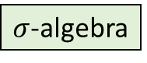
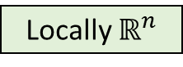
Understanding fundamental structures
Hamiltonian mechanics
Phase space (symplectic manifold)
Hamiltonian evolution
Differentiable manifold
Symplectic structure
Manifold
Differentiable structure
We cannot truly understand this if we don’t first understand this
Topological space
Locally $ℝ^{n}$
Probability space
I.e. Before saying “there is a 50% chance to get tails” we need to define what tails, chance and 50% mean
Even probability spaces
are not fundamental structures
Set of points
$σ$-algebra
Measure
We want to understand what each mathematical element represents physically, and when and why their use is fully justified in science

Slide 5
Space of the well-posed scientific theories
Physical theories
Specializations of the general theory under the different assumptions
Hamiltonian mechanics
Unitary evolution
Quantum state-space
Classical phase-space
Assumptions
Infinitesimal reducibility
Determinism/
reversibility
Irreducibility
States and processes
General theory
Informational granularity
Basic requirements and definitions valid in all theories
Experimental verifiability

Slide 6
Assumptions of Physics
Objectives:
Develop a mathematical framework that can serve as the foundation for all scientific theories (e.g. a mathematical theory about scientific theories)
Start from physical principles and assumptions and derive the math (not start from the math and add the physics later through an “interpretation”)
Each mathematical object must have a clear physical meaning (no object is unphysical, can read math proofs as logical arguments on the physics)
Construct concepts and tools that span different disciplines (nature does not care about divisions in fields of knowledge)
Explore what happens when the assumptions fail, possibly leading to new physics ideas

Slide 7
Index
Overview
Relationship between physics and math
The logic of experimental verifiability
Properties and quantities
Information granularity and experimental quantification
States and processes
Classical mechanics
Quantum mechanics
Thermodynamics
Statistical mechanics

Slide 8

Relationship between physics and math

Slide 9
Two parallel “systems”
Necessary because the formal system will not be able to formalize all aspects
Only formalize what is fruitful
Axioms brings concepts from the informal to the formal system
Declare existence of certain objects with certain properties within the formal system
Definitions bring relationships between informal concepts to the formal system
Further specialize formal concepts that already exist
Both axioms and definitions require justifications (i.e. informal proofs)
Informal
Formal
physics
math

Slide 10
The formal system is made “crisp” by leaving out the parts that are fuzzy, therefore the formal system is not a perfect representation
E.g. real numbers are “less faithful” than finite precision measurements because they assume precision can be improved indefinitely
We know what the formal objects represent because we start from the informal physical definition
Meaning cannot be simply sprinkled on top of a mathematical framework later with an “interpretation” as the map between math and physics is many-to-many
Informal
Formal
physics
math

Slide 11
The logic of experimental verifiability

Slide 12
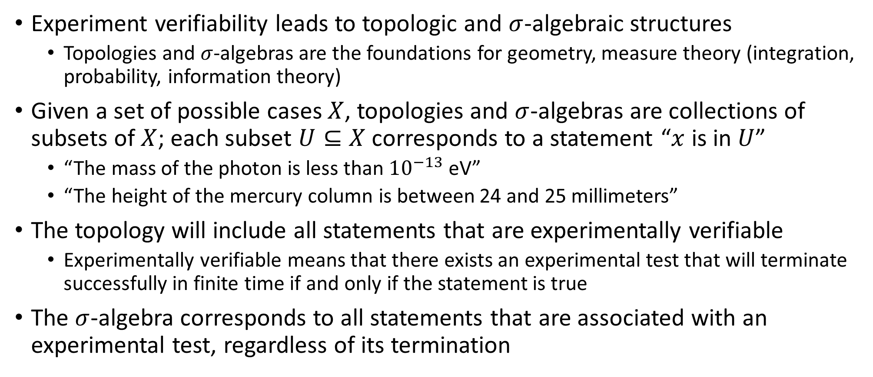
In brief
Experiment verifiability leads to topologic and $σ$-algebraic structures
Topologies and $σ$-algebras are the foundations for geometry, measure theory (integration, probability, information theory)
Given a set of possible cases $X$, topologies and $σ$-algebras are collections of subsets of $X$; each subset $U⊆X$ corresponds to a statement “$x$ is in $U$”
“The mass of the photon is less than ${10}^{−13}$ eV”
“The height of the mercury column is between 24 and 25 millimeters”
The topology will include all statements that are experimentally verifiable
Experimentally verifiable means that there exists an experimental test that will terminate successfully in finite time if and only if the statement is true
The $σ$-algebra corresponds to all statements that are associated with an experimental test, regardless of its termination

Slide 13
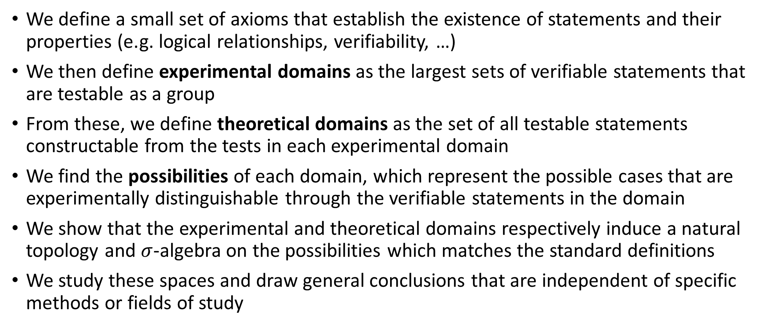
General approach
We define a small set of axioms that establish the existence of statements and their properties (e.g. logical relationships, verifiability, …)
We then define experimental domains as the largest sets of verifiable statements that are testable as a group
From these, we define theoretical domains as the set of all testable statements constructable from the tests in each experimental domain
We find the possibilities of each domain, which represent the possible cases that are experimentally distinguishable through the verifiable statements in the domain
We show that the experimental and theoretical domains respectively induce a natural topology and $σ$-algebra on the possibilities which matches the standard definitions
We study these spaces and draw general conclusions that are independent of specific methods or fields of study

Slide 14
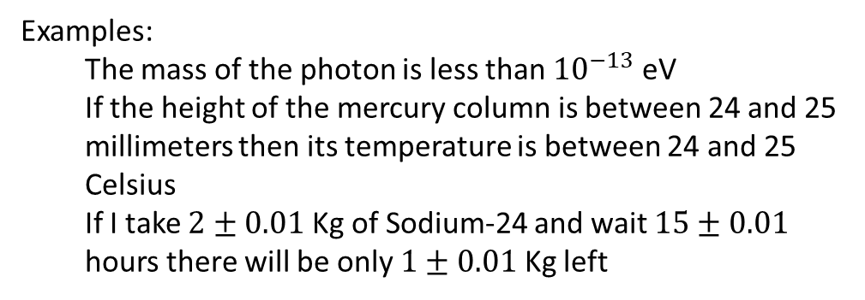
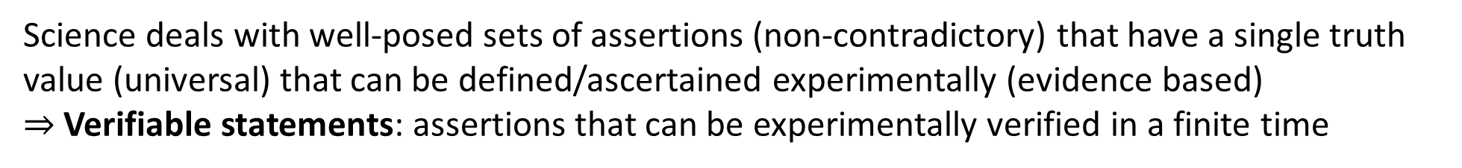

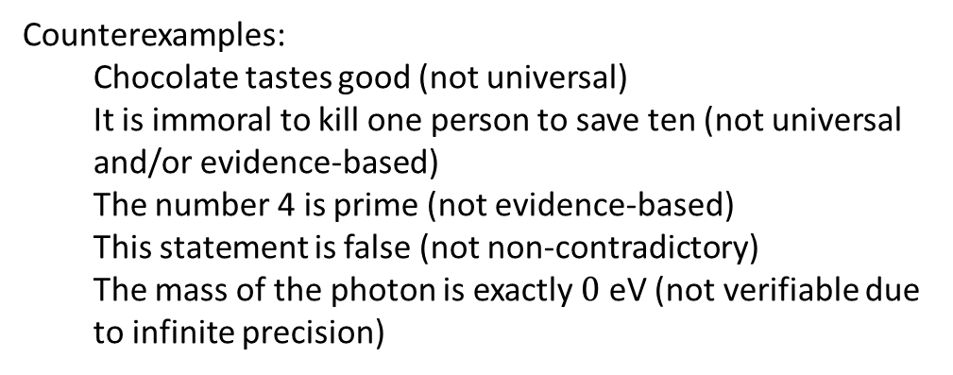
Science deals with well-posed sets of assertions (non-contradictory) that have a single truth value (universal) that can be defined/ascertained experimentally (evidence based) $⇒$ Verifiable statements: assertions that can be experimentally verified in a finite time
Examples:
The mass of the photon is less than ${10}^{−13}$ eV
If the height of the mercury column is between 24 and 25 millimeters then its temperature is between 24 and 25 Celsius
If I take $2±0.01$ Kg of Sodium-24 and wait $15±0.01$ hours there will be only $1±0.01$ Kg left
Counterexamples:
Chocolate tastes good (not universal)
It is immoral to kill one person to save ten (not universal and/or evidence-based)
The number 4 is prime (not evidence-based)
This statement is false (not non-contradictory)
The mass of the photon is exactly $0$ eV (not verifiable due to infinite precision)
We have to keep in mind that the meaning of the statements, their relationships and what truth values are allowed depends on context (e.g. premise, theory, etc…)
The mass of the electron is 511 $±$ 0.5 KeV
When measuring the mass, it is a verifiable hypothesis
When performing particle identification, it is assumed to be true

Slide 15
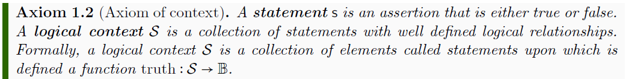
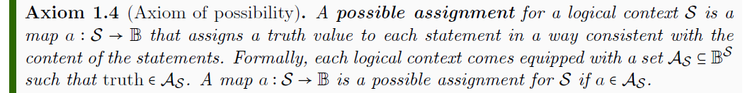
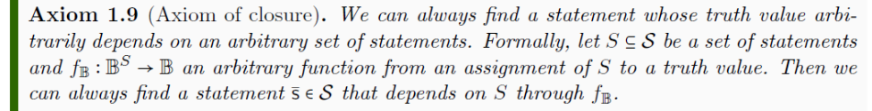
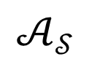
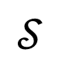
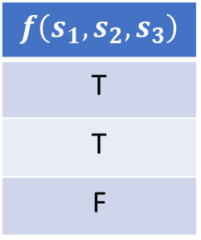
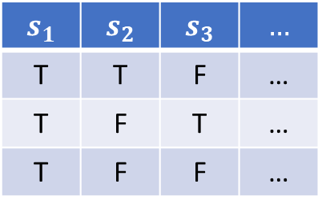

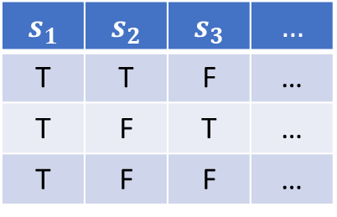
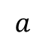
Axioms of logic
$$𝒮$$
$$s_{1}$$ | $$s_{2}$$ | $$s_{3}$$ | $$…$$
T | T | F | …
T | F | T | …
T | F | F | …
$$a$$
$$𝒜_{𝒮}$$
$$s_{1}$$ | $$s_{2}$$ | $$s_{3}$$ | $$…$$
T | T | F | …
T | F | T | …
T | F | F | …
$$f\left(s_{1},s_{2},s_{3}\right)$$
T
T
F
$$f_{𝔹}$$

Slide 16
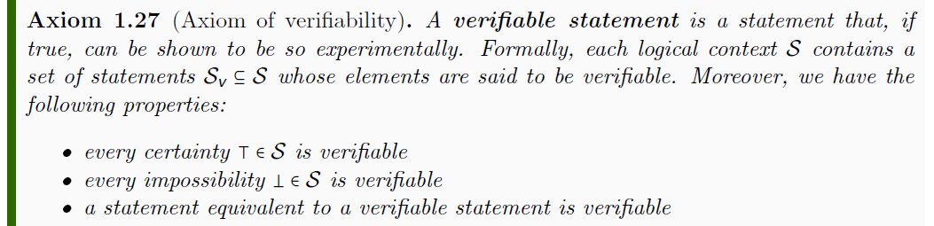
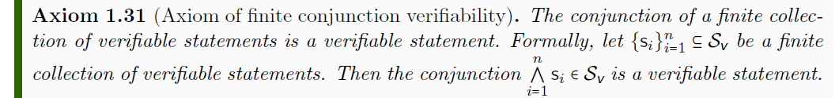
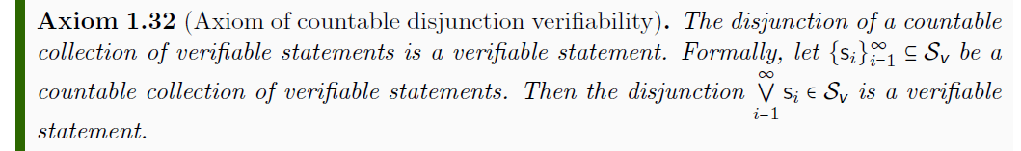
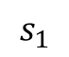
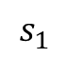
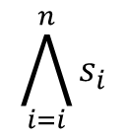
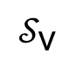
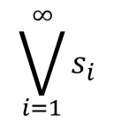
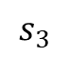
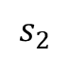
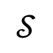

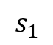
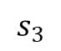
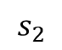
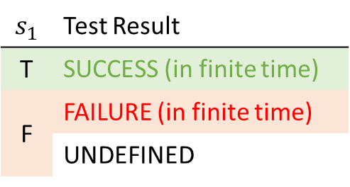
Axioms of verifiability
$$𝒮$$
$$s_{1}$$ | Test Result
T | SUCCESS (in finite time)
F | FAILURE (in finite time)
 | UNDEFINED
$$𝒮_{\text{v}}$$
$$s_{1}$$
experimental test
$$\bigwedge_{i=i}^{n}{s_{i}}$$
$$s_{1}$$
$$s_{2}$$
$$s_{3}$$
All tests must succeed
$$\bigvee_{i=1}^{∞}{s_{i}}$$
$$s_{1}$$
$$s_{2}$$
$$s_{3}$$
$$…$$
One successful test is sufficient

Slide 17
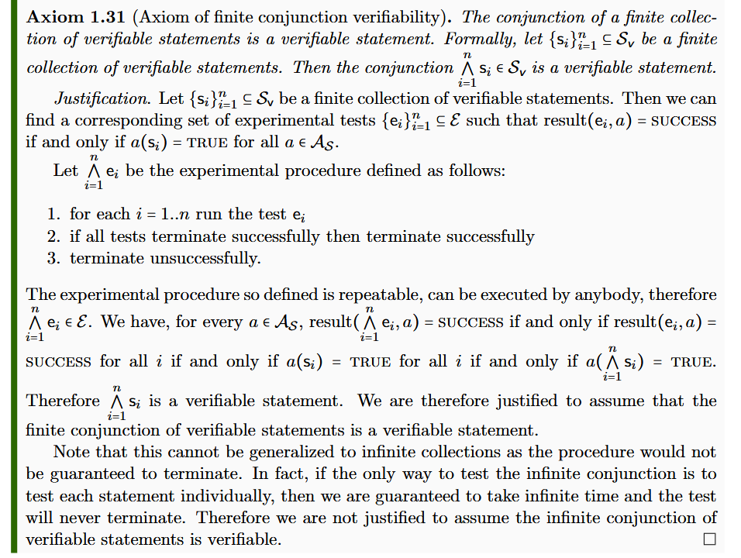
Justifications
As an example, here is the justification for finite conjunction verifiability
Note how the style is similar to a formal proof
However, the tests are never formalized, and the procedure defined is not “precise” in a modern mathematical sense
The style would probably have been considered mathematically precise centuries ago

Slide 18
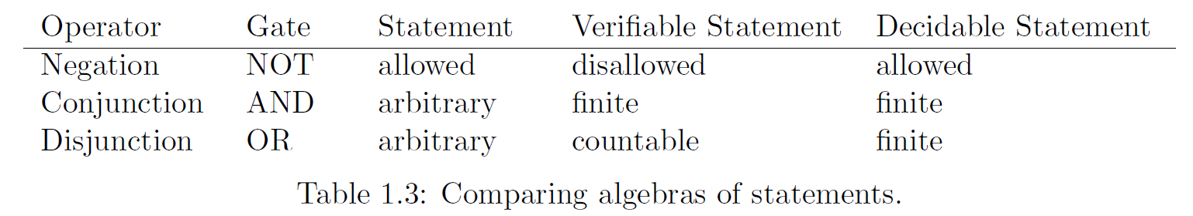
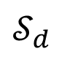
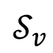
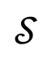
Properties of the logic system
Different algebras for the different types of statements
$$𝒮_{d}$$
$$𝒮_{v}$$
$$𝒮$$
(Different) notions of equivalences
Are the same statement
“This animal is a bird” = “Questo animale e’ un uccello”
“This animal is a bird” ≡ “This animal has feathers”
truth(“This animal is a bird”) = truth(“That animal is a mammal”)
Always have the same truth
Happen to have the same truth

Slide 19
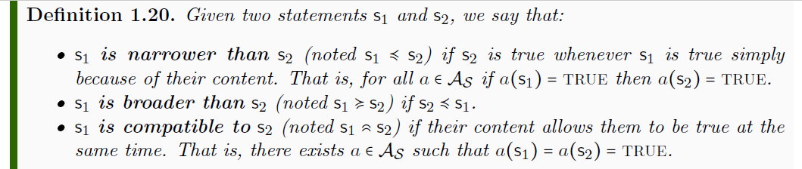
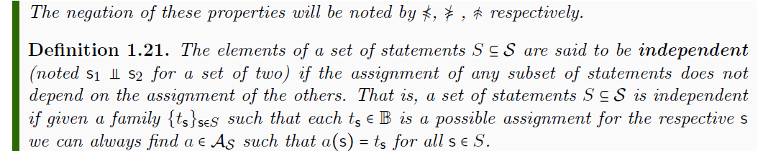
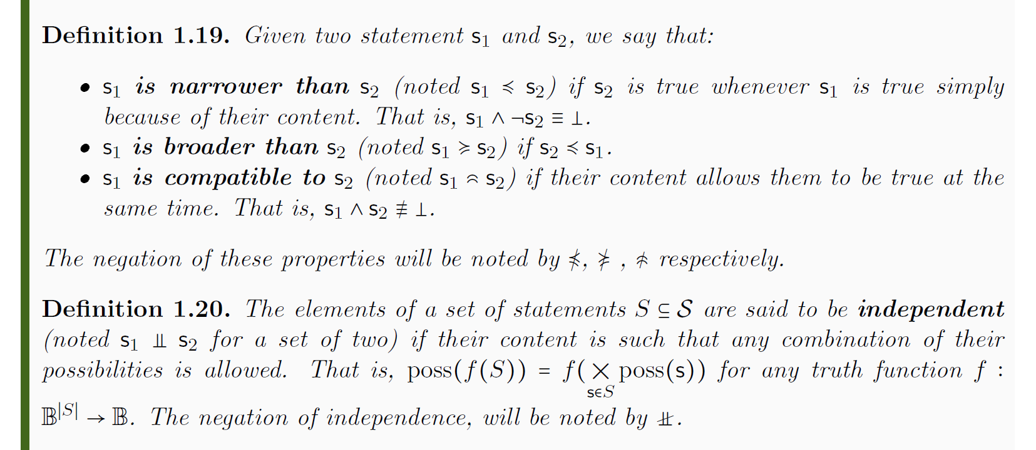
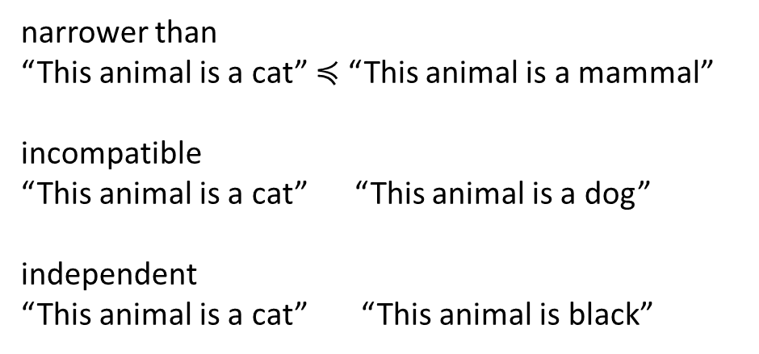
Properties of the logic system
Other logic relationships
narrower than
“This animal is a cat” $≼$ “This animal is a mammal”
incompatible
“This animal is a cat” “This animal is a dog”
independent
“This animal is a cat” “This animal is black”
Minimal set of axioms (easy to justify)
Allows us to capture experimental verification
Allows us to describe relationships of the type we have in science
Gives us a basic structure all other structures have to “play nice” with

Slide 20

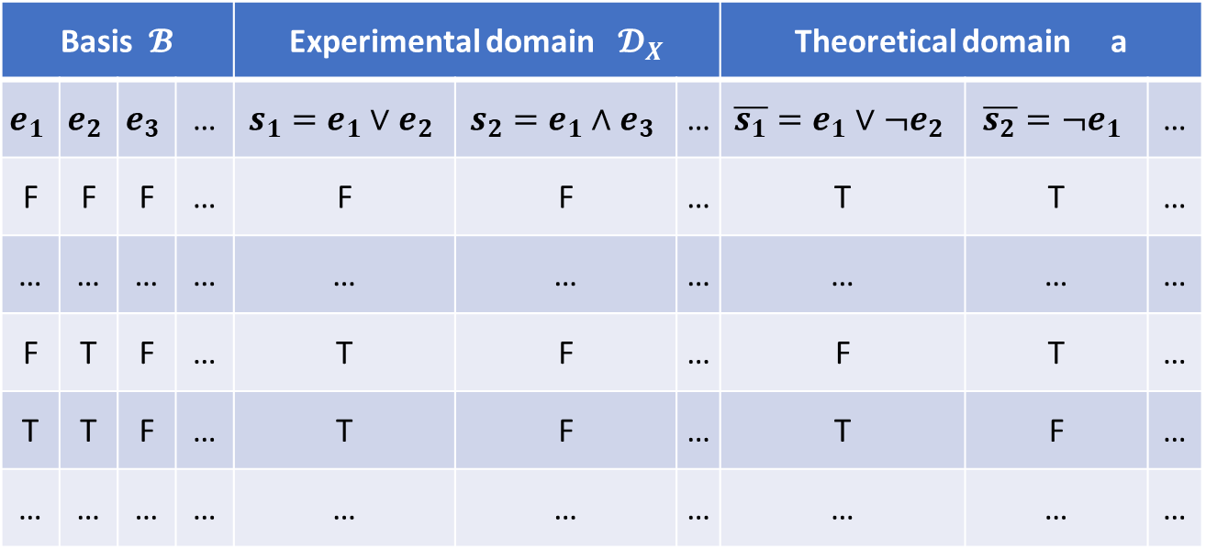

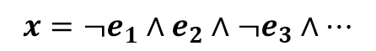
Experimental domains (scientific models)
From them generate all verifiable statements (close under finite AND countable OR)
Generate all meaningful predictions
(close under negation as well)
Start with a countable set of verifiable statements
Basis $𝓑$ |  |  |  | Experimental domain $𝓓_{X}$ |  |  | Theoretical domain a
$$e_{1}$$ | $$e_{2}$$ | $$e_{3}$$ | … | $$s_{1}=e_{1}∨e_{2}$$ | $$s_{2}=e_{1}∧e_{3}$$ | … | $$\overline{s_{1}}=e_{1}∨¬e_{2}$$ | $$\overline{s_{2}}=¬e_{1}$$ | …
F | F | F | … | F | F | … | T | T | …
… | … | … | … | … | … | … | … | … | …
F | T | F | … | T | F | … | F | T | …
T | T | F | … | T | F | … | T | F | …
… | … | … | … | … | … | … | … | … | …
${\overline{𝓓}}_{X}$
Fill in all possible assignments
Possibilities $X⊂{\overline{𝓓}}_{X}$
The points of the space (the possibilities, the distinguishable cases) are not given a priori but are constructed from the chosen verifiable statements
$$x=¬e_{1}∧e_{2}∧¬e_{3}∧…$$
For each possible assignment we have a theoretical statement that is true only in that case. We call these statements possibilities of the domain.

Slide 21
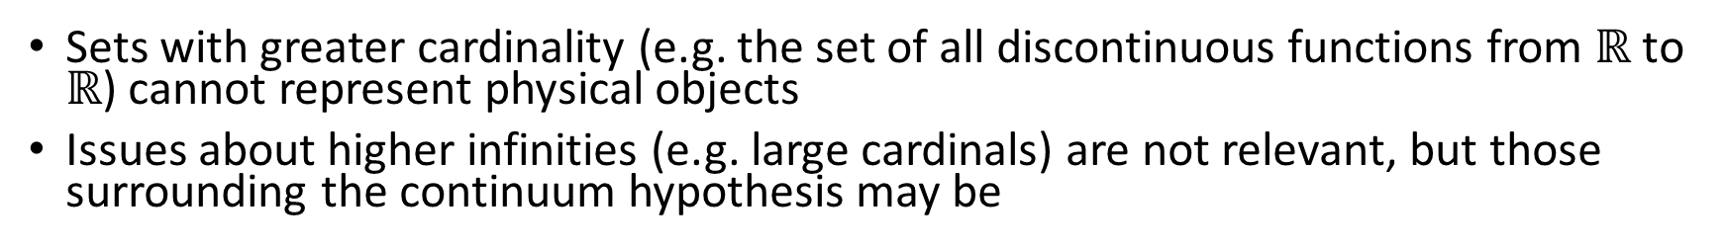

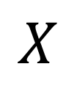

Maximum cardinality of distinguishable cases
Set of distinguishable cases
Test results for countable basis
Correspond to binary expansion
$$ℝ$$
FTFFFTTTFTFTT…
TFFTTFTTFFFTF…
FTFFFTTFTFFTF…
FTTFTFTTFTFFT…
0.0100011101011…
0.1001101100010…
0.0100011010010…
0.0110101101001…
1
Correspondence to binary sequence
0100011101011…
1001101100010…
0100011010010…
0110101101001…
$$X$$
$\left|X\right|≤|ℝ$|
0
Sets with greater cardinality (e.g. the set of all discontinuous functions from $ℝ$ to $ℝ$) cannot represent physical objects
Issues about higher infinities (e.g. large cardinals) are not relevant, but those surrounding the continuum hypothesis may be
Notes:
Large cardinals are defined to have a specific property and their existence cannot be proven (or disproven) in standard ZFC.

Slide 22
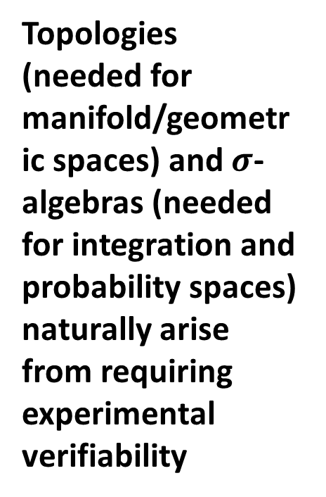
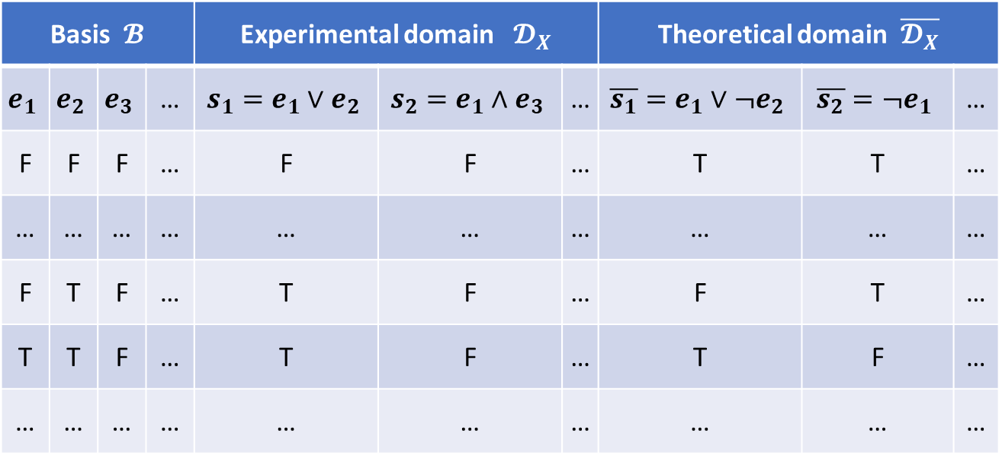
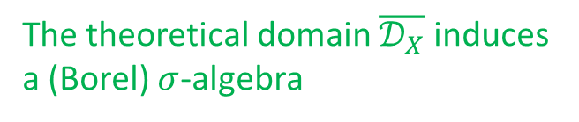
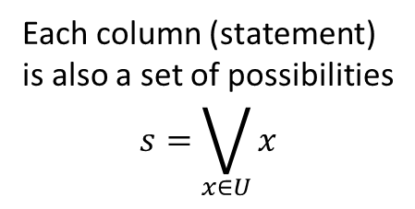
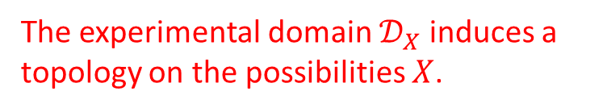

Topologies and $σ$-algebras
Each column (statement) is also a set of possibilities $$s=\bigvee_{x∈U}{x}$$
Finite AND and countable OR become finite intersection and countable union
Negation and countable AND become
complement and countable union
Basis $𝓑$ |  |  |  | Experimental domain $𝓓_{X}$ |  |  | Theoretical domain $\overline{𝓓_{X}}$
$$e_{1}$$ | $$e_{2}$$ | $$e_{3}$$ | … | $$s_{1}=e_{1}∨e_{2}$$ | $$s_{2}=e_{1}∧e_{3}$$ | … | $$\overline{s_{1}}=e_{1}∨¬e_{2}$$ | $$\overline{s_{2}}=¬e_{1}$$ | …
F | F | F | … | F | F | … | T | T | …
… | … | … | … | … | … | … | … | … | …
F | T | F | … | T | F | … | F | T | …
T | T | F | … | T | F | … | T | F | …
… | … | … | … | … | … | … | … | … | …
Topologies (needed for manifold/geometric spaces) and $σ$-algebras (needed for integration and probability spaces) naturally arise from requiring experimental verifiability
Possibilities $X$
The experimental domain $𝒟_{X}$ induces a topology on the possibilities $X$.
The theoretical domain $\overline{𝒟_{X}}$ induces a (Borel) $σ$-algebra

Slide 23
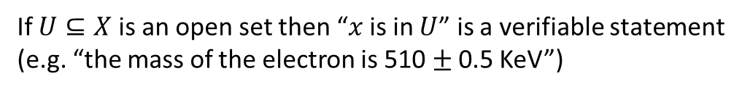







Topologies and $σ$-algebras
$int(A)$ corresponds to the verifiable part of a statement
All definitions and all proofs about these structures have precise physical meaning in this context
$$s_{1}$$ | Test Result
T | SUCCESS (in finite time)
 | UNDEFINED
F | UNDEFINED
 | FAILURE (in finite time)
$∂A$ corresponds to the undecidable part of a statement
$ext(A)$ corresponds to the falsifiable part of a statement
If $U⊆X$ is an open set then “$x$ is in $U$” is a verifiable statement (e.g. “the mass of the electron is 510 $±$ 0.5 KeV”)
Topologies and $σ$-algebras each capture part of the formal structure
For us, they are part of a single unified structure
If $V⊆X$ is a closed set then “$x$ is in $V$” is a falsifiable statement (e.g. “the mass of the electron is exactly 510 KeV”)
If $A⊆X$ is a Borel set then “$x$ is in $A$” is a theoretical statement: a test can be created, though we have no guarantee of termination (e.g. “the mass of the electron in KeV is a rational number” is undecidable, the test will never terminate)

Slide 24


Physical meaning of separation axioms
All topologies are Kolmogorov (i.e. $T_{0}$)
Possibilities are experimentally well-defined i.e. possibilities constructible from a base by countable AND/OR and NOT (singletons in the $σ$-algebra)
The topology is $T_{1}$ if all possibilities are approximately verifiable
Possibilities are the limit of a sequence of verifiable statements i.e. possibilities are the countable conjunction of verifiable statements
The topology is Hausdorff (i.e. $T_{2}$) if all possibilities are pairwise experimentally distinguishable
Given two possibilities, we can find a test that confirms one and excludes the other
i.e. for any $x_{1},x_{2}∈X$ there is a statement $s∈{\overline{𝒟}}_{X}$ such that $x_{1}≼s$ and $x_{2}≼¬s$
$$s$$ | Test Result | $$x_{1}$$ | $$x_{2}$$
T | SUCCESS (in finite time) | T | F
 |  | F
 | UNDEFINED
F | UNDEFINED
 | FAILURE (in finite time)
 | FAILURE (in finite time) |  | T

Slide 25


Examples
Standard topology on integers Decidable domain (all statements are decidable)
Discrete topology (every set is clopen); topology and $σ$-algebra both coincide with the power set
0
1
2
3
4
5
6
…
Standard topology on the reals Finite precision measurements (open intervals are verifiable)
Topology generated by open intervals (coincides with order and metric topology); separable, complete, connected (no clopen sets except full and empty set); $σ$-algebra is the Borel algebra (strict subset of power set)

Slide 26


Examples
Does extra-terrestrial life exist?
Semi-decidable question
Topology $\left\{∅,\left\{Y\right\},\left\{Y,N\right\}\right\}$ is strictly $T_{0}$; $σ$-algebra is the power set
Y
N
How many leptons are there? (through direct observation)
Can only measure lower bound (e.g. “there are at least $i$”)
Topology contains empty set and $\left\{i, i+1, i+2, …\right\}$ for all $i$; strictly $T_{0}$; $σ$-algebra is the power set
0
1
2
3
4
5
6
…

Slide 27




Inference/causal relationships and continuity
An inference relationship is a map $𝓇:𝒟_{Y}→𝒟_{X}$ such that $𝓇\left(s\right)≡s$
$$𝒟_{X}$$
$$𝒟_{Y}$$
e.g. the water temperature is between 0 and 0.52 Celsius or between 7.6 and 9.12 Celsius
e.g. the water density is between 999.8 and 999.9 kg/m³
$$X$$
$$Y$$
e.g. the water temperature is exactly 4 Celsius
e.g. the water density is exactly 1 kg/m³
A causal relationship is a map $f:X→Y$ such that $x≼f\left(x\right)$
Two general and important results:
1) Two domains admit an inference relationship if and only if they admit a causal relationship
2) The causal relationship must be a continuous map in the natural topology

Slide 28

Other general results
Every set of experimentally distinguishable cases will be a second-countable topological space
Domain composition allows us to put experimental domains together (i.e. closes under finite conjunction and countable disjunction)
It works as a product space: possibilities of the combined domain are a subset of the Cartesian product of the possibilities of the domains
Different relationships between domains will yield different results:
Independent domains: possibilities are the Cartesian product, topology is the product topology
Incompatible domains: possibilities are the disjoint union and the topology is the disjoint union topology
Dependent domain: the dependent domain is effectively contained in the independent one, so the combined domain coincides with the independent one
Given $𝒟_{X}$ and $𝒟_{Y}$, we can always mathematically create the relationship domain $𝒟_{C\left(X,Y\right)}$, where each possibility represents a possible relationship between domains (i.e. a continuous function)
However, we are not guaranteed that the test exists (i.e. testing the relationship physically requires more than testing the input and the output)

Slide 29

Additional remarks
A “science first” formal structure is possible
Physically meaningful, mathematically precise, philosophically consistent
Precise science/math dictionary
“Well-behaved” mathematical objects are really “well-defined” physical objects
Experimental verifiability is the basis for scientifically well-defined objects
Topologies and $σ$-algebras arise from scientific epistemological requirements, not from ontological features of the universe
Most other structures used in science (differential geometry, measure theory, probability theory, Lie algebras, …) are based on topologies and $σ$-algebras
No progress in the foundations of physics is possible without proper understanding of these connections

Slide 30
Status: formalized
Experimental verifiability is already mathematically formalized in the first two chapters of the book
It both shows that a “science first” formal structure is possible and provides a template for joint mathematical and physical precision
Possible areas of improvements/extensions
Deductive projections: given an experimental domain, for each statement in the context we can define the narrowest broadest statement (the most we can deduce within the domain if the statement is true)
Characterize topologically the space of all possible relationships
Find physical correspondents for other topological concepts (e.g. all other separation axioms)

Slide 31
Properties and quantities

Slide 32
In brief
The idea is that the possibilities are, in practice, labeled by properties, which we want to characterize in the framework
E.g. “the animal is a Felis catus”, “the mass of the object is 1 Kg”
Properties may only partially identify a possibility
E.g. “the horizontal position in the plane is 1 m”
Properties must be experimentally defined (i.e. possibilities of an experimental subdomain)
Quantities are ordered properties
I.e. we can compare the values and determine which is smaller or greater
Want to understand the necessary and sufficient assumptions to “construct” numeric values from experimental verification (real numbers in particular)

Slide 33

General approach
A property is of a system is a tuple $(𝒬,q)$ where $𝒬$ is a topological space, and $q:U→𝒬$ is a continuous function such that $U⊆𝒬$ is a verifiable (i.e. open) set
A quantity is a property together with a linear order $≤$ such that the topology of $𝒬$ is the order topology with respect to $≤$
Quantities can be defined experimentally through references, which define before, on and after relationships with the object being measured
i.e. the mark on a ruler or on a jar, the tick of a clock, the reference weight of a scale, …
Quantities can only be defined by a set of aligned strict (i.e. before/on/after mutually exclusive) refinable (i.e. gaps and overlaps can be filled) references
Integers and reals are the only two types of quantities for which the domain always “looks the same” for every value (i.e. always have a successor – or not; all verifiable statements decidable – or not; …)

Slide 34
TODO
One (visual) slide for properties
One (visual) slide for quantities
One (visual) slide for references
Two slides for ordering theorems

Slide 35
Status: formalized
Definitions and theorems for properties and quantities are formalized in chapter 3 of the book
Possible areas of improvements/extensions
Extend to manifold

Slide 36
Information granularity and experimental quantification

Slide 37

In brief
The general idea is to rederive geometric and measure theoretic concepts from the ability to compare the granularity of the descriptions provided by different statements
Narrowness can only compare granularity if one statement is “contained” in another
“The position of the object is between 0 and 1 meters” $≼$ “The position of the object is between 0 and 1 kilometers”
“The fair die landed on 1” $≼$ “The fair die landed on 1 or 2”
“The first bit is 0 and the second bit is 1” $≼$ “The first bit is 0”
We need a new operator $⋖$ called fineness that compares the granularity of non-overlapping regions; equigranularity $≐$ is the symmetrization of fineness
“The position of the object is between 0 and 1 meters” $⋖$ “The position of the object is between 2 and 3 kilometers”
“The fair die landed on 1” $⋖$ “The fair die landed on 3 or 4”
“The first bit is 0 and the second bit is 1” $⋖$ “The third bit is 0”

Slide 38

General approach
The question is: what is a minimal set of physically justifiable properties that allows us to recover geometry and measure theory from fineness?
More specifically, pick a statement $u∈\overline{𝒟}$ which we call unit
We want to find a function $μ_{u}:\overline{𝒟}→ℝ$ such that:
Normalized: $μ_{u}\left(u\right)=1$
Monotonic: $s_{1}$ $⋖$ $s_{2}$ means $μ_{u}\left(s_{1}\right)≤μ_{u}(s_{2})$
Additive: if $s_{1}$ incompatible with $s_{2}$ then $μ_{u}\left(s_{1}∨s_{2}\right)=μ_{u}\left(s_{1}\right)+μ(s_{2})$

Slide 39

Related works
We haven’t found much in the literature to solve the problem
Some inspiration from comparative probability (De Finetti, Villegas et al.)
Haven’t found any work after the 1980s. Is anybody still working in this field?
Main problem: work on a single bounded measure, while we need a hierarchy of measures
A single measure does not allow us to say: “The horizontal position of the object is exactly 0 meters” $⋖$ “The horizontal position of the object is exactly 1 or 2 meters” $⋖$ “The horizontal position of the object is between 0.5 and 1.5 meters” $⋖$ “The horizontal position of the object is between 1.5 and 3.5 meters”
Some inspiration from order theory
The issue is that going from narrowness on statements to fineness on granularity levels is an order homomorphism, but it is not a Boolean homomorphism – haven’t found suitable tools
Suggestions are welcome

Slide 40

Three known basic requirements
Three basic requirements on narrowness have been identified
Boundedness: if $s∈\overline{𝒟}$ is a contingent statement, then $⊥⋖s⋖⊤$ (i.e. impossibilities are finest and certainties are coarsest)
Transitivity: if $s_{1}$ $⋖$ $s_{2}$ and $s_{2}$ $⋖$ $s_{3}$ then $s_{1}$ $⋖$ $s_{3}$
Offset monotonicity: if $s$ is incompatible (i.e. disjoint) with $s_{1}$ and $s_{2}$, then $s_{1}$ $⋖$ $s_{2}$ if and only if $s∨s_{1}$ $⋖$ $s∨s_{2}$ (i.e. we can “add” the same statement on each side of the inequality)
These 3 axioms allow us to rederive a whole set of properties
Fineness is a pre-order, fineness is monotonic with respect to narrowness, …

Slide 41

Possible domain requirements
Equigranularity of possibilities: for all $x_{1},x_{2}∈X$ we have $x_{1}≐x_{2}$
In this case, if we pick a possibility as a unit, the measure is the counting measure; that is:
$μ_{x}\left(s\right)=\left|A\left(s\right)\right|$ where $A(s)$ is the set of possibilities corresponding to the statement
Equigranularity of possibilities is sufficient for uniqueness of the measure, but is not necessary
E.g. $x_{1}∨x_{2}≐x_{3}$ and $x_{1}≐x_{2}$ also leads to a unique measure: $μ_{x_{1}}\left(x_{1}\right)=1=μ_{x_{1}}\left(x_{2}\right)$ and $μ_{x_{1}}\left(x_{3}\right)=2$
Equigranularity of possibilities depends on the domain
E.g. removing elements from the basis may “collapse” different possibilities into one, leading to coarser possibilities
It is the hallmark of a “well-posed” domain, since all the possibilities carry equal information

Slide 42

Possible domain requirements
Totality: for all $s_{1},s_{2}∈\overline{𝒟}$ either $s_{1}$ $⋖$ $s_{2}$ or $s_{2}$ $⋖$ $s_{1}$ (i.e. all statements are comparable in fineness)
This is necessary to define the measure on the whole domain; however, it is not a desirable property
Statements about different physical dimensions (e.g. pressure, volume, position, momentum) should not be comparable
In fact, we want to use lack of comparability and infinite comparability (e.g. length vs area vs volume) to define a unit system
What we would need is a way to identify a set of totally comparable statements that include the unit
We have no clear idea of what would be necessary conditions, except imposing directly that such a set exists

Slide 43

Infinitesimals and Archimedean property
A group possesses the Archimedean property if there are no infinitesimals
I.e. for all $x$ and $y$ we can find an $n$ such that $\begin{matrix}x+x+…+x≥y \\ n times \end{matrix}$
Unless the domain has finitely many possibilities, it will not be Archimedean
The choice of unit will determine which statements are infinitesimal with respect to the unit (and therefore measure zero) and which will be infinite (and therefore infinite measure)
Furthermore, we distinguish between countable infinitesimals (i.e. countably many will add up to the unit) and uncountable infinitesimals (i.e. countably many will never add up to the unit)
If the unit admits countable infinitesimals, then the measure can only be finitely additive
Still need to understand whether the lack of countable infinitesimals is sufficient for countable additivity

Slide 44

Remarks
The goal is certainly achievable
We can always impose the specific requirements similar to what is done with manifolds (i.e. you define a manifold to be a topological space locally isomorphic to $ℝ^{n}$ without finding a set of necessary and sufficient conditions)
Finding the underlying assumptions would help us better understand the whole structure
What are infinitesimals and how is calculus constructed?
How is the notion of statement independence (i.e. truth of a statement not fixing the truth of other statements) related to the information independence (i.e. the measure is the product)?
Can an additive measure always be constructed? (i.e. what happens at Planck scale?)

Slide 45
Status - Conceptual
We believe we have identified all the main ingredients, which are summarized in a blueprint paper
Numerous details need to be addressed to fully outline the concepts
Find what are the “necessary” axioms for fineness
Find what are the “optional” properties a domain need to satisfy to allow for measures
Understand how infinitesimals work and how can analysis be connected
Understand how differentiability can be defined on top of the framework
Understand how “linear scales” can be defined on top and whether/how it links to inertial frames

Slide 46
States and processes

Slide 47

Motivation
So far we have characterized statements in terms of verifiability and information granularity; we need to understand how and why statements are “grouped” into sets that belong to the same “system”
The naïve idea is that states are simply descriptions of a system at a particular time, which would make them possibilities of a domain $𝒟_{t}$; this does not work
The states that a system can possibly occupy at a given moment changes in time: after enough time, a dissipative system will be certainly found in equilibrium
It doesn’t tell us why we group statements in a specific way: why do position and momentum, pressure and volume form “good pairs”? Why don’t we pair momentum and volume?
The general idea is that the state space is the set of possibilities for an independent system
The object must allow, at least in some cases, a process for which its description is independent from other systems (e.g. we can talk about a ball because we can manipulate its position and velocity independently of other balls)

Slide 48

General approach
Define a process domain to be the experimental domain of all possible statements at all times
An evolution is the possibility of the process domain, which would determine the truth for all statements at all times
Picking a unit, we have a measure on the descriptions that “counts” the evolutions associated to that description
The process entropy is the logarithm of that count
Then we look at how experimental subdomains at particular time intervals relate to each other
Independent domains will factor both in terms of description and in terms of measure (and therefore entropy is additive)
The state space of a system is the template for the domains at all times
At each time, there is an experimental domain that instantiates the state space (i.e. “the property $x$ is in $U$ when $t$ in $ΔT$” )
The template is taken when the system is independent: states are descriptions of the system and only about the system; no correlations

Slide 49
State space of a system

Slide 50



State space of a system at different times
$$t−Δt$$
$$t$$
$$t+Δt$$

Slide 51
Evolution: complete description of the system at all times
$$t−Δt$$
$$t$$
$$t+Δt$$

Slide 52
A process defines the set of all possible evolutions
$$t−Δt$$
$$t$$
$$t+Δt$$

Slide 53



Each description at each time corresponds to a set of evolutions
We can count the number of evolutions for a particular state $s$ at a particular time with a measure* $μ(s)$ since $s$ identifies a set of evolutions.
$$μ=2$$
$$μ=1$$
$$μ=2$$
$$t−Δt$$
$$t$$
$$t+Δt$$
* The full mathematical characterization is a bit more complicated (i.e. preorder that leads to a family of measures)… but conceptually it is like that

Slide 54



The probability $P\left(s_{1} | s_{0}\right)$ of having $s_{1}$ given $s_{0}$ corresponds to the fraction of evolutions that go from state $s_{0}$ to state $s_{1}$
That is, $P\left(s_{1} | s_{0}\right)=\frac{μ\left(s_{0}∩s_{1}\right)}{μ\left(s_{0}\right)}$
$$50\%$$
$$t−Δt$$
$$t$$
$$t+Δt$$

Slide 55
A process is deterministic if knowing the state at a time allows us to predict the state at a future time
For these processes, we can properly write a law of evolution $s\left(t+Δt\right)=f\left(s\left(t\right)\right)$
$$t−Δt$$
$$t$$
$$t+Δt$$

Slide 56






In a deterministic process, the evolutions can never split, only merge
That is, $μ\left(s\left(t+Δt\right)\right)≥μ\left(s\left(t\right)\right)$
$$μ=1$$
$$μ=2$$
$$μ=1$$
$$μ=1$$
$$μ=3$$
$$t−Δt$$
$$t$$
$$t+Δt$$

Slide 57
A process is reversible if knowing the state at a time allows us to reconstruct the state at a past time
$$t−Δt$$
$$t$$
$$t+Δt$$

Slide 58






In a reversible process, the evolutions can never merge, only split
That is, $μ\left(s\left(t+Δt\right)\right)≤μ\left(s\left(t\right)\right)$
$$μ=1$$
$$μ=3$$
$$μ=2$$
$$μ=1$$
$$μ=1$$
$$t−Δt$$
$$t$$
$$t+Δt$$

Slide 59

In a det/rev process, evolutions can never merge nor split
That is, $μ\left(s\left(t+Δt\right)\right)=μ\left(s\left(t\right)\right)$
$$t−Δt$$
$$t$$
$$t+Δt$$

Slide 60

For a deterministic process
$$μ\left(s\left(t+Δt\right)\right)≥μ\left(s\left(t\right)\right)$$
(equal if reversible)

Slide 61
Consider a process where a system reaches a final equilibrium that can be predicted from the initial state
At equilibrium, evolutions cannot merge anymore
$$t−Δt$$
$$t$$
$$t+Δt$$

Slide 62

For a deterministic process
$$μ\left(s\left(t+Δt\right)\right)≥μ\left(s\left(t\right)\right)$$
(equal if reversible)
(maximum at equilibrium)

Slide 63






Suppose we have a composite of two systems
$$𝒮_{1}$$
$$𝒮=𝒮_{1}×𝒮_{2}$$
$$\left\{x\left(t\right),y\left(t\right)\right\}$$
$$𝒮_{2}$$
$$x(t)$$
$$y(t)$$
State space is the product
Evolutions, in general, are not the product: there may be correlations between the evolutions

Slide 64





Suppose we have a composite of two systems
If the systems are independent, the evolution of one does not constrain the evolution of the other: all pairs are possible
$$\left\{x\left(t\right),y\left(t\right)\right\}$$
For each pair of states there is a state for the composite system: $\#(𝒮)=\#(𝒮_{1})\#(𝒮_{2})$
For each pair of evolutions there is an evolution of the composite: $μ\left(s_{1}∩s_{2}\right)=μ_{1}\left(s_{1}\right)μ_{2}(s_{2})$
$$x(t)$$
$$y(t)$$
Note: $log μ=\log{μ_{1}μ_{2}}=\log{μ_{1}}+\log{μ_{2}}$
$log μ$ is additive for independent systems

Slide 65


Define the process entropy as $S=\log{μ}$
The log of the count of evolutions per state
It is additive for independent systems
$$S=S_{1}+S_{2}$$
For a deterministic process
$S\left(s\left(t+Δt\right)\right)≥S\left(s\left(t\right)\right)$ (equal if reversible)
(maximum at equilibrium)

Slide 66
Process entropy
We have not mentioned uncertainty, disorder, statistical distributions, information, lack of information, …
Therefore those concepts are not fundamental in this context
We have not discussed what type of state or system we have (classical, quantum, biological, economic, …)
Therefore everything we said is valid independently of the type of system, which would explain the success of thermodynamic ideas outside the realm of physics
The process entropy increase is explained by the definitions and the settings (processes with equilibria that depend on the initial state)
The explanation is straightforward (i.e. does not require a complicated discussion)
The explanation is not mechanical (i.e. given by a particular mechanism)

Slide 67
Process entropy
The main difference is that process entropy is process dependent
The same state in different processes (or in the same process at different times) will yield a different process entropy
We typically think of entropy as state dependent
I.e. it is a state variable
In what circumstances can process entropy be associated to the state? And why?

Slide 68









Note: if we want to “switch” processes, the evolution count at the junction must be uniquely defined
$$A$$
$$A$$
$$x$$
$$B$$
$$B$$
$$C$$
$$C$$
This is at least one reason why we would want to have a well defined entropy at the states at the junction points
$$…$$
$$…$$

Slide 69









Equilibria can be assigned a unique entropy
Suppose the same state $x$ is an equilibrium for two processes $A$ and $B$
$$A$$
$$x$$
$$B$$
$$x$$
Two ways of combining the processes: first A then B and vice versa
$$B$$
$$x$$
$$A$$
$$x$$
All the evolutions of $A$that end in $x$ will also end in $x$ under $AB$ and $B$
All the evolutions of $B$that end in $x$ will also end in $x$ under $BA$ and $A$
Number of evolutions of $x$ must be independent of the process
Equilibria allow us to assign unique (maximal) entropy to states

Slide 70

For composite systems, recall
that in general the process entropy is not unique
$$\left\{x\left(t\right),y\left(t\right)\right\}$$
Due to correlations between subsystems
If the systems are independent, however, the process entropy is well defined
$$x(t)$$
$$y(t)$$
It sums and corresponds to the maximum
System independence allows us to assign unique (maximal) entropy to composite states

Slide 71

State entropy
We have found a simple notion of entropy (logarithm of the count of evolutions) that has a fundamental (almost trivial) link to irreversibility
We can assign a unique maximal process entropy to “states of independent equilibria” and which we call state entropy
Both equilibria and independence maximize process entropy
We leave these notions somewhat “vague” for now (we are still doing better than standard thermodynamics anyway)
Given a set $X$ of states of equilibria, we can define the function $S:X→ℝ$ that returns the state entropy for each equilibrium
We call this the equation of state in entropic form
What exactly is the link between states and “independent equilibria”?

Slide 72






1) Process composition: we like to divide processes (including experiments) into a series of steps stitched together
produce $X$
prepare $X$
interaction
measure $X$
produce $Y$
prepare $Y$
measure $Y$
At the junction point, the evolution count from both processes for the same state has to match, physical theory must take that into account
States are junction points

Slide 73


2) Measurement finiteness: on closer inspection, measurements are not at an instant (or at a point); they are defined on a neighbourhood; $x(t)$ is really $x\left[\left(t−\frac{dt}{2},t+\frac{dt}{2}\right)\right]$
$$x$$
Dynamics at a faster/smaller scale than the measurement resolution
We can talk about a single state in the interval if all state variables are “stable” enough
States are equilibria of faster/smaller scale processes

Slide 74
3) Independent description: a state should describe the system and only the system (with minimal correlations)
$$𝒮=𝒮_{1}×𝒮_{2}$$
$$𝒮_{1}$$
A state is properly defined on an independent system, when all correlations have been removed
$$𝒮_{2}$$
States are independent descriptions

Slide 75
States are junction points
States are equilibria of faster/smaller scale processes
States are independent descriptions
The very notion of state is linked to equilibrium and state entropy (i.e. a unique, maximized evolution count)
These requirements are things we, maybe implicitly, look for when defining systems and states (epistemic desiderata); if they are not satisfied we change the system/state definition until they are; we look for sets of variables that “go together” in that way
All states are, in this sense, independent equilibria

Slide 76
Note: the notion of equilibrium as “nothing is changing” does not really work and needs to be amended
Take a volume of gas at equilibrium
It should be at equilibrium for every observer, yet only in the rest frame nothing is changing
Moreover, in presence of gravity, gas at equilibrium must follow geodesics
Relativistically, “nothing is changing” makes no sense
So, let’s try and find a way to put all these insights together in a consistent picture

Slide 77
To define a system we must define a boundary and what happens at the boundary
We need to say what is part of the system and what is not part of the system.
The interaction of the system at the boundary must be such that the system remains well defined. E.g. We can talk about a ball because we are on the surface of the earth at 20 Celsius. If we were on the surface of the sun, we would not be able to define a ball.
These processes must happen at a faster timescale than the one we are studying, so that we can consider the system well defined at all times.

Slide 78
To define a system we must define a boundary and what happens at the boundary
To characterize a system, we must have (at least in principle) processes at our disposal that render it independent
The state of the system should not tell us how the system came to be in that state, what process must act on it afterwards; it shouldn’t tell us anything more about its subsystems and their internal dynamics, other systems or the environment than what the system strictly tells us. If the system is independent, its description gives us the least amount of information, it selects the biggest number of possible evolutions.
Historically, we have been grouping quantities (e.g. position/momentum, pressure/volume, electric/magnetic fields) in such a way to achieve that goal (e.g. form independent degrees of freedom). We don’t define states by randomly putting quantities together.

Slide 79
To define a system we must define a boundary and what happens at the boundary
To characterize a system, we must have (at least in principle) processes at our disposal that render it independent
If the system is well defined and independent, this “decoupling process” does nothing: states are equilibria of this process
Mathematically, states are symmetries (i.e. invariants, equilibria) of a group (i.e. a set of transformations, a set of processes). Properly defining a system, then, means giving not only a set of states, but a set of processes for which the states are equilibria that maximize the process entropy

Slide 80
States
All states are really “independence equilibria” of some process
At the boundary, the process is such to keep the system well defined
The process minimizes the correlation with the environment, removes all correlations with other systems, subsystems and their dynamics such that the system is allowed an independent description
A measurement at the level of the system tells us nothing about the rest
They can be used as junction points under process composition, as they are defined independently of past and future processes
They are descriptions of the system when process entropy is maximized
They describe the evolution of the system and only of the system
State entropy is well-defined in these and only these conditions
Outside these assumptions, we can still have processes but we are not going to have systems and states
The whole would not decouple into definite parts with properties independent of each other

Slide 81

Physical theories
Different assumptions depending on the system and processes at hand
Thermodynamics, classical Hamiltonian mechanics, Newtonian mechanics, quantum mechanics, ….
State spaces
Group descriptions that can be grouped into patterns of independent behavior
Systems, state space, state entropy, state variables, process composition
Processes
Algebra of descriptions that can be parametrized by time
Process entropy, determinism/reversibility,
stochastic processes
Informational granularity
Ability to compare the granularity of the description provided by different statements (count possible cases)
Units, measures, geometry, probability,
differentiability
Logical consistency +
Experimental verification
Algebra of statements generated from a countable set of verifiable statements
Topologies, (Borel) $σ$-algebras, continuous functions, properties and quantities

Slide 82
Status - pre-conceptual
We have identified many crucial pieces but we don’t feel we have fully understood exactly what they are
Progress can be achieved either by improving the concepts or by outlining the ones we already have
Build on the idea of entropy as count of evolutions to outlines how it works exactly for different types of evolutions and equilibria
Understand exactly what “independence”, the property required to be able to define a system, is at a conceptual level

Slide 83
Classical mechanics

Slide 84

In brief
Classical mechanics can be rederived from three assumptions
Infinitesimal reducibility: giving the state of the whole system is equivalent to giving the state of its infinitesimal parts $→$ classical phase space
Deterministic and reversible evolution: given the state at a time, we can predict the state at future times (deterministic) and reconstruct the state at past times (reversible) $→$ Hamiltonian mechanics
Kinematic equivalence: the state of the system is fully identify by the spatial trajectories of the system $→$ Lagrangian mechanics, massive particles under scalar forces
We also recover the idea that phase space areas count states (i.e. the fundamental postulate of statistical mechanics) and the theory is automatically relativistic.

Slide 85
General approach
Infinitesimal reducibility tells us that the system as a whole is identified by a distribution over the states of the infinitesimals (i.e. particles). The density needs to be defined independently of the state variables, which lead to invariant areas (i.e. symplectic form/invariant state counts) and the structure of phase space.
Deterministic and reversible evolution tells us that the density on past states must be transported exactly to the future state. In an inverted version of Liouville’s theorem, conservation of state counts gives us Hamiltonian dynamics.
Kinematic equivalence tells us that we can express the distribution over kinematic variables (i.e. position and velocity). This will force a linear transformation between velocity and momentum, which constrains the evolution to that of massive particles under potential forces.

Slide 86






Assumption of infinitesimal reducibility
The system is reducible to its parts: giving the state of the whole is equivalent to giving the state of the parts. The system can be subdivided indefinitely.
time
$𝒮$ is the state of the infinitesimal parts (i.e. particles)
$$ℝ$$
$$𝒮$$
$U$ is a set of possible states for the particles
$$U$$
$V$ is a set of possible amounts of materials
We’ll have statements of the form “the amount of material found in $U$ is within the range $V$”
Assuming that the amount over disjoint areas sums, the state of the system can be characterized by a distribution $ρ:𝒮→ℝ$

Slide 87






Assumption of infinitesimal reducibility
The system is reducible to its parts: giving the state of the whole is equivalent to giving the state of the parts. The system can be subdivided indefinitely.
time
The state of the whole is given by a distribution over the state of the infinitesimal parts (i.e. particles)
$$ρ:𝒮→ℝ$$
$$ρ\left(𝓈\left(ξ^{a}\right)\right)=ρ\left(ξ^{a}\right)$$
Density expressed in terms of state variables
Under a change of variables
$${\hat{ξ}}^{b}={\hat{ξ}}^{b}\left(ξ^{a}\right)$$
$$𝓈\left(ξ^{a}\right)=𝓈\left({\hat{ξ}}^{b}\right)$$
$$ρ\left(ξ^{a}\right)=\left|\frac{∂ξ^{a}}{∂{\hat{ξ}}^{b}}\right|ρ\left({\hat{ξ}}^{b}\right)$$
$$ρ\left(𝓈\left(ξ^{a}\right)\right)=ρ\left(𝓈\left({\hat{ξ}}^{b}\right)\right)$$
we have
We need the distribution to change both as a density and be an invariant

Slide 88









Invariant densities
Densities must be defined upon areas that are invariant under unit transformations
$\hat{q}=100 cm/m q$
For each state variable $q$ that defines a unit there must be a variable $k$ defined on the inverse unit
$$1$$
$$1$$
$Δk=1 m^{−1}$
$Δ\hat{k}=0.01 cm^{−1}$
$Δ\hat{q}=100 cm$
$Δq=1 m$
Number of possibilities for the degree of freedom $ΔqΔk$is invariant
$$ρ(q^{i},k_{i})=ρ({\hat{q}}^{j},{\hat{k}}_{j})$$
$$∫ρ\left(q^{i},k_{i}\right)dq^{n}dk^{n}=∫ρ\left({\hat{q}}^{j},{\hat{k}}_{j}\right)d{\hat{q}}^{n}d{\hat{k}}^{n}$$
The structure of phase space is exactly what is needed to define frame invariant densities over particle states
Without it we couldn’t compare whether we had more particles in one state or another

Slide 89









Hamiltonian evolution
Deterministic and reversible evolution means that densities (including marginals) are mapped exactly from initial to final states
$$ρ\left(𝓈\left(t\right)\right)=\hat{ρ}\left(𝓈\left(t+Δt\right)\right)$$
$$k_{i}$$
Possibilities (area) within a d.o.f. conserved
$${\hat{k}}_{i}$$
$$(q^{y},k_{y})$$
$$({\hat{q}}^{y},{\hat{k}}_{y})$$
$$q^{i}$$
$${\hat{q}}^{i}$$
Independent d.o.f. remain
independent (orthogonal)
$$(q^{x},k_{x})$$
$$({\hat{q}}^{x},{\hat{k}}_{x})$$
This is exactly what Hamilton’s equations do
Hamiltonian mechanics is just bookkeeping of the count of possibilities for each independent degree of freedom
Nothing else

Slide 90









Hamiltonian mechanics for one degree of freedom
Displacement along the trajectory
$\vec{S}=\left(\frac{dq}{dt},\frac{dp}{dt},\frac{dt}{dt}\right)$
$$q$$
Deterministic and reversible: flux over a closed surface is zero
$$div\left(\vec{S}\right)=0$$
$$\vec{S}=−curl(\vec{θ})$$
Because $\frac{dt}{dt}=1$ we can choose a gauge such that:
$$t$$
$$p$$
$\vec{θ}=\left(p, 0, −H\left(q,p\right)\right)$
This recovers Hamilton’s equations
$\vec{S}=\left(\frac{dq}{dt},\frac{dp}{dt},\frac{dt}{dt}\right)=\left(\frac{∂H}{∂p},−\frac{∂H}{∂q}, 1\right)=curl\left(−\vec{θ}\right)$

Slide 91









Lagrangian mechanics for one degree of freedom
Since $γ$ is parallel to $\vec{S}$, $\vec{S}$ is tangent $Σ$
$−\iint_{Σ}{\vec{S}×d\vec{Σ}}=0$
$$q$$
Use Stokes theorem, note that $dγ=\vec{S}dt$,
ignore second order terms
$=\iint_{Σ}{curl(\vec{θ})×d\vec{Σ}}$
$$γ$$
$$Σ$$
$$γ′$$
$=\int_{γ}{\vec{θ}}⋅\vec{S}dt−\int_{γ^{′}}{\vec{θ}}⋅\vec{S}dt$
$$t$$
$δ\int_{γ}{\vec{θ}⋅\vec{S}dt}=0$
$$p$$
This recovers the principle of stationary action of Lagrangian mechanics
$\vec{θ}⋅\vec{S}=\left(p, 0, −H\left(q,p\right)\right)⋅\left(\frac{dq}{dt},\frac{dp}{dt},\frac{dt}{dt}\right)=p\frac{dq}{dt}−H=L$

Slide 92




Conservation of information entropy
Information entropy is invariant over and only over the transformations for which the density is invariant
$$ρ\left(ξ^{a}\right)=\left|\frac{∂ξ^{a}}{∂{\hat{ξ}}^{b}}\right|ρ\left({\hat{ξ}}^{b}\right)$$
$$−\int_{𝒮}{ρ log\left(ρ\right)dξ^{a} }=−\int_{𝒮}{ρ log\left(ρ\right)d{\hat{ξ}}^{b} }−\int_{𝒮}{ρ log\left|\frac{∂ξ^{a}}{∂{\hat{ξ}}^{b}}\right|d{\hat{ξ}}^{b} }$$
Invariant distributions are precisely the distribution upon which entropy is invariant
If the evolution is deterministic and reversible, the information to identify the initial state is the same to identify the final state <-> Hamiltonian mechanics
$$I\left[ρ_{t}\right]=I_{0}=I\left[ρ_{t+Δt}\right]$$
If we fix the entropy, the gaussian distribution minimizes the spread
$$I_{G}=ln⁡(2πe σ_{q}σ_{k})$$
$$σ_{q}σ_{k}≥\frac{\exp\left(I_{0}\right)}{2πe}$$
During the evolution the spread over phase space is bounded

Slide 93
Status - pre-formal
The full derivation is rigorous for physics standards. Connections to a formal mathematical framework are already established.
The last step is to fully formalize the arguments
Most crucial aspect is to define in exact mathematical terms what is an invariant density
Since not all the prerequisites are fully formalized, we need to understand what elements we should consider given (e.g. define an infinitesimally reducible system already in terms of integrable density)

Slide 94
Quantum mechanics

Slide 95

In brief
Quantum mechanics differs from classical mechanics mainly from the first assumption, and that we have two different types of evolutions
Irreducibility: giving the state of the whole system does not tell us nothing about its parts $→$ quantum state space
Deterministic and reversible evolution: $→$ Unitary evolutions
Deterministic and irreversible evolution with equilibria: $→$ Projections
Kinematic equivalence: $→$ Lagrangian mechanics, massive particles under scalar forces
Note that reversible evolution can be recovered as quasi-static irreversible evolution

Slide 96
General approach
Irreducibility implies that quantum states are ensembles. In particular, they have to be equilibria and they must all have the same entropy. The state space, in a sense, is the state of random variables that are uniformly distributed over the undefined properties.
Projections describe the processes that lead to equilibria (i.e. idempotent processes). Each state is the outcome of such a process
Note that projections for each subspace is a definitional property for Hilbert spaces
The inner product tells us how the randomness/undefinedness for two states is similar (norm) and how it is correlated (phase difference)
Inner product is bilinear like the covariance and it similar properties under linear combination

Slide 97






Divisible
vs
Reducible
There exists a process where the final state consists of two or more independent systems (e.g. $𝒫_{t} :𝒮 →𝒮_{1}×𝒮_{2}$)
The state of the whole can be expressed as the state of the parts at the same time (e.g. $𝒮≡𝒮_{1}×𝒮_{2}$)
Planarian is divisible into three planaria (but not reducible to them)
A magnet is reducible to its north and south pole (but not divisible into them)
Muon is divisible into an electron and two neutrinos (but not reducible to them)
A proton is reducible to its quarks (but not divisible into them)

Slide 98






Divisible
vs
Decomposable
There exists a process where the final state consists of two or more independent systems (e.g. $𝒫_{t} :𝒮 →𝒮_{1}×𝒮_{2}$)
We can calculate a property by combining independent contributions (e.g. $+ :𝒮×𝒮→𝒮$ and $F\left(𝓈_{1}+𝓈_{2}\right)=F\left(𝓈_{1}\right)+$ $F\left(𝓈_{2}\right)$)
Reducible
An infinitesimal line segment is decomposable along coordinates (it is not divisible nor reducible to them)
The state of the whole can be expressed as the state of the parts at the same time (e.g. $𝒮≡𝒮_{1}×𝒮_{2}$)
$$dλ$$
$$dy{ e}_{y}$$
$$dx{ e}_{x}$$
Divisibility and reducibility are matter-of-fact properties of the system
(under given circumstances)
Decomposability (i.e. linearity) can be defined only over the properties that are linear on that decomposition (if they exist)
The work along an infinitesimal line segment is linear: $dW\left(dλ\right)=F_{x}dx+F_{y}dy$
The length of the line segment is not linear: $ℒ\left(dλ\right)≠dx+dy$

Slide 99
Assumption of irreducibility
The system is irreducible to its parts: giving the state of the whole tells us nothing about the states of the parts.
?
time
Irreducibility does not mean there are no parts and there is no internal dynamics: it means the dynamics is not accessible
We do not have a way to interact with each “fragment” independently from the rest of the system, we cannot gather information about them
Irreducibility is not purely a property of the system: it depends on the process under study and the tools at our disposal
We can treat the proton as a single quantum system in many cases
We can’t when we perform deep inelastic scattering at suitable wavelength

Slide 100









Invariant distribution over random variables
State of the fragments is unknowable
Defined by “internal” random variables Still needs invariant distributions
which we take to be uniform (homogeneity)
Transformations that break uniformity are not allowed: only linear transformations
$$Y$$
$$X$$
$$Y$$
$$X$$
Only significant “internal” changes are those that change the integral (i.e. variance and covariance)
Some linear transformations have no effect Choose $X$ and $Y$ such that $ρ=1$ and $σ_{X}=σ_{Y}$, which means $∫ρdxdy∝σ_{X}σ_{Y}=σ_{X}^{2}$
$$\hat{Y}$$
$$\hat{X}=aX+bY \\ \hat{Y}=−bX+aY$$
$$\hat{X}$$
Internal transformations are identified by a complex number $𝒯(a+ıb):𝒮→𝒮$
The square modulus ${\left|a+ıb\right|}^{2}=a^{2}+b^{2}$ represents the change in variance and the phase represents the change in correlation as the arccosine of the Pearson correlation coefficient $ρ_{X,𝒯\left(a+ıb\right)\left(X\right)}=cos(\arg\left(a+ıb\right))$

Slide 101



Invariant distribution over random variables
The complex plane represents the space of pairs of random variables
A complex number represents one variable
The second one is implied by the symplectic structure (closing the square)
$$σ_{X+Y}^{2}=σ_{X}^{2}+σ_{Y}^{2}+2σ_{X}σ_{Y}ρ_{X,Y} \\ {\left|c_{1}+c_{2}\right|}^{2}={\left|c_{1}\right|}^{2}+{\left|c_{2}\right|}^{2}+2\left|c_{1}\right|\left|c_{2}\right|cos⁡(Δθ)$$
Linear composition obeys addition of random variables, variance adds linearly only if variables are uncorrelated
Homogeneity $→$ different d.o.f. carry the same spread and correlation A single complex plane for all d.o.f.
Pearson coefficient
The state space is a complex vector space
Complex inner product $\left\langle X | Y\right\rangle =σ_{X}σ_{Y}e^{ı arccos⁡(ρ_{X,Y})}$ gives variance and correlation information
The rest is mostly standard arguments
Measurable quantities must have a real valued average over all states $→$ Hermitian operators
Deterministic and reversible evolution must preserve the inner product $→$ unitary evolution $→$ Schroedinger equation
No real justification for Hilbert space, though
Cauchy limits are not necessarily physical
Assuming the expectations for all polynomials of $Q$ and $P$ are finite gives us Schwartz space

Slide 102




Other approach: time vs level of scale
A (probably better) variation is to use past/future measurements as the unknowns instead of the internal structure
No need to characterize an internal structures that is assumed to be undetermined
State is the experimentally accessible information of the system at that time
State is a bundle of evolutions of unit size
System independence mean the probability of transition depends only on the state of the system, and the result cannot be predicted by other means
$$\left|x^{+}\right\rangle$$
$$\left|y^{+}\right\rangle$$
$$\left|x^{−}\right\rangle$$
$$\left|y^{−}\right\rangle$$

Slide 103


Effects due to irreducibility
Minimum uncertainty
$$k$$
Suppose arbitrarily small spread -> internal dynamics more and more constrained -> we can know more about it -> contradiction
In fact, all states must be associated with the same information entropy (which is set to zero)
$$q$$
Non-locality
System spread in space -> interact within a region -> but can’t interact with only a part-> must be interacting with the rest of the system as well
Superluminar effects …
… that can’t carry information
Suppose the internal dynamics is constrained by the speed of light -> we know something about the internal dynamics -> contradiction
Suppose we can use the internal dynamics to carry a message -> we have a way to manipulate the internal dynamics -> contradiction

Slide 104


Classical state
Quantum state
$$ρ(q^{i},k_{i})$$
$$ψ(q^{i})$$
Information Entropy
?
time
time
0
We always have access to the internal dynamics
We have no access to the internal dynamics
Any initial value for information entropy is allowed: we can study arbitrarily small parts
All pure quantum states have the same information entropy (i.e. zero): no description for parts

Slide 105
Status - pre-outline
The concepts are identified and it is clear how they lead/justify quantum effects. The exact mathematical argument is still in flux.
Best way forward is to tighten the parts we do have and zone in on the remaining mathematical details
The idea of using past/future descriptions in place of hidden variables seems extremely promising
See how much can be reused from signal processing/stochastic processes

Slide 106
Thermodynamics

Slide 107
In brief
The idea is that thermodynamics studies composed system under processes that start and end with independent parts and can be recovered from the following definitions/assumptions
A thermodynamic process is one where all parts are independent from each other
A thermodynamic system allows a description for which all state variables are extensive
Energy is a special quantity that is additive for all independent systems and is conserved under all deterministic processes

Slide 108
General approach
System independence means the evolution of one system does not constrain the evolution of the other (i.e. the measure over time evolutions factorizes)
Entropy is defined as the logarithm of the count of evolutions; it is additive and maximized for independent systems
Thermodynamic equilibria is redefined to be when all parts of the system are independent from each other (at all level of scale)
A thermodynamic process is a deterministic process whose final state is a thermodynamics equilibrium
It maximizes entropy because system independence maximizes entropy
The conservation of energy allows us to define two types of energy exchanges:
Energy exchanged at equal entropy is work
Energy exchanged at maximum entropy is heat

Slide 109









Suppose we take a composite system and at some point we split it such that each part will follow its own process
$$x$$
$$B$$
$$x_{1}$$
$$(x_{0},y_{0})$$
$$A$$
$$(x,y)$$
$$y$$
$$C$$
$$y_{1}$$
Not only we need a well defined evolution count for the composite, but also for each part
This requires us to extended the notion of equilibria to the parts

Slide 110







Thermodynamic process
Thermodynamic processes extend the notion of deterministic process with equilibria to composite systems
We define a thermodynamic process as a deterministic process with equilibria such that:
in the final equilibrium all parts are independent and at equilibrium
the final equilibrium depends non-trivially on the initial state of any part
at equilibrium
$$X⋃Y$$
$$X⋃Y$$
$$A$$
$$X$$
$$Y$$
$$X$$
$$Y$$
non-trivial dependence
independent

Slide 111










Thermodynamic equilibrium
$$…$$
A thermodynamic equilibrium is the output of a thermodynamic process
Two systems are in thermodynamic equilibrium if they are parts of the same thermodynamic equilibrium
$$X⋃Y⋃Z$$
$$…$$
$$X⋃Y$$
$$Y⋃Z$$
$$…$$
Mathematically, systems under composition form a Boolean algebra. An equilibrium is a downward set with a greatest element.
$$X$$
$$Y$$
$$Z$$
$$…$$

Slide 112

Thermodynamic equilibrium
$$…$$
Based on the definitions, we can show that thermodynamic equilibrium is transitive
Suppose $A$ is in thermodynamic equilibrium with $B$ and $B$ is in thermodynamic equilibrium with $C$.
Then $A$ and $B$ are parts of the output of the same thermodynamic process. But $B$ and $C$ are also parts of the output of the same thermodynamic process.
Therefore $A$ and $C$ are parts of the output of the same thermodynamic process: they are in thermodynamic equilibrium.
$$X⋃Y⋃Z$$
$$…$$
$$X⋃Y$$
$$Y⋃Z$$
$$…$$
$$X$$
$$Y$$
$$Z$$
$$…$$
This recovers the zeroth law of thermodynamics

Slide 113

Thermodynamic systems
We say $A$ is a thermodynamic system if
the state space $𝒮_{A}$ is formed by states of equilibrium
all state variables (i.e. quantities that identify the state of the system) are extensive properties of the system (i.e. sum under system composition, like entropy)*
One of these quantities, called internal energy, is conserved under all thermodynamic processes
We will indicate with $U$ the internal energy and with $x^{i}$ all other state variables
* It may be possible to derive the existence of extensive quantities… For now we leave this as an extra assumption

Slide 114

Existence of an equation of state
Because the states are equilibria, we have a function $S:𝒮_{A}→ℝ$ that returns the (maximized) evolution entropy for each state.
Because $(U,x^{i})$are state variables, we can express $S(U,x^{i})$ as a function of the variables.
A system $A$ with the previous properties has an equation of state $S(U,x^{i})$

Slide 115

Thermodynamic quantities
Define the following variables:
$β=\frac{1}{k_{B}T}=\frac{∂S}{∂U}$ and $−βX_{i}=\frac{∂S}{∂x^{i}}$
$$dS=\frac{∂S}{∂U}dU+\frac{∂S}{∂x^{i}}dx^{i}=βdU−βX_{i}dx^{i} \\ k_{B}TdS=dU−X_{i}dx^{i} \\ dU=T\left(k_{B}dS\right)+X_{i}dx^{i}$$
Compare to $dU=TdS_{Thermo}−pdV+μ_{i}dN^{i}+…$
$k_{B}dS$ corresponds to the thermodynamic entropy
The other variables correspond to thermodynamic pairs

Slide 116
Changes of energy and entropy
Now we want to study how changes in energy and changes in entropy relate to each other
To do that, is useful to characterize two “orthogonal” directions:
changes of energy at equal entropy
changes of energy at maximum entropy change

Slide 117

Reservoir
We define a reservoir $R$ as a thermodynamic system where the energy $U_{R}$ is the only state variable and $\frac{∂S_{R}}{∂U_{R}}=β_{R}=\frac{1}{k_{B}T_{R}}=const$. We call heat $Q=−ΔU_{R}$ the energy lost by the reservoir during a transition.
Heat is energy exchanged under a purely entropic change
no other extensive quantity changes

Slide 118

Mechanical system
We define a mechanical system $M$ as a system such that the entropy is the same for all states. That is: $S_{M}\left(U_{M},x_{M}^{i}\right)=const$. We call work $W=ΔU_{M}$ the energy acquired by a purely mechanical system during a transition.
$$dS_{M}=0=β_{M}dU_{M}−β_{M}X_{Mi}dx_{M}^{i}$$
$$dU_{M}=X_{Mi}dx_{M}^{i}$$
Work is energy exchanged at constant entropy. Constant entropy (as we saw) corresponds to deterministic and reversible processes. The energy is effectively “stored” in the other variables and can be later retrieved.

Slide 119






First law
Consider a composite system made of a generic system $A$, a reservoir $R$ and a purely mechanical system $M$. Consider a transition where we go to a new equilibrium.
Since the energy is extensive (i.e. additive under system composition), let $U$ be the total energy. We also assumed the energy is conserved. We have:
$ΔU=0=ΔU_{A}+ΔU_{R}+ΔU_{M}=ΔU_{A}−Q+W$
$ΔU_{A}=Q−W$
$$R$$
$$Q$$
$$A$$
$$M$$
$$W$$

Slide 120

Second law
Since entropy is extensive (i.e. additive under system composition) let $S$ be the total entropy. Since the process is deterministic, the entropy cannot decrease. We have:
$0≤ΔS=ΔS_{A}+ΔS_{R}+ΔS_{M}=ΔS_{A}+β_{R}ΔU_{R}+0=ΔS_{A}+\frac{−Q}{k_{B}T_{R}}$
$k_{B}ΔS_{A}≥\frac{Q}{T_{R}}$
The entropy we defined in our initial discussion is actually closely related to the thermodynamic entropy
$$R$$
$$Q$$
$$A$$
$$M$$
$$W$$

Slide 121


Recall the definition of state entropy
Count of evolutions
$S=\log{μ(x)}$
$$μ=3$$

Slide 122


Recall the definition of state entropy
Count of evolutions
$S=\log{μ(x)}$
$μ=$ 1
The least we can have is a single evolution
The case where the equilibrium can be reached from only one starting condition
$S≥\log{1}=0$
State entropy is non-negative, bounded from below at zero
Evolution of a pure ground state fits into the single evolution case
This recovers part of the third law of thermodynamics

Slide 123






Existence of equilibria forces $S(U)$ to be concave
$$b$$
$$a$$
$$S$$
Since $S(U)$ is non-negative, we have three cases:
a) No maximum energy, entropy monotonically increasing b) No minimum energy, entropy monotonically decreasing
c) Minimum and maximum energy, entropy minimum at either edge
$$c$$
$$U$$
The first 2 cases can’t both exist:
If we combined two systems, one strictly monotonically increasing with another strictly monotonically decreasing, maximization of entropy would happen at infinity: we have no equilibrium
By convention, we say energy is bounded from below. Minimum entropy is reached at the lowest energy state.
This recovers the remaining part of the third law of thermodynamics

Slide 124
Thermodynamics recovered
The laws of thermodynamics as we recovered them apply simply because of the properties of the processes we decide to focus on
The notion of process entropy maps to thermodynamic entropy in a very natural way
The notion of thermodynamic equilibrium as an equilibrium at all scales is already something people discuss (citation needed)
We have not mentioned uncertainty, disorder, statistical distributions, information, lack of information, …
We have not discussed what type of state or system we have (classical, quantum, biological, economic, …)

Slide 125
Status - outline
While the presentation can be improved and some details clarified, the overall picture is solid and the arguments are simple/clear enough.
Two main directions of improvement: clean up what we have and start the formalization processes
A full write-up, teaching material, videos, … are all things we need to do
Formalization could probably be done simply by using manifolds with boundaries (the boundary being the set of equilibrium states) and differential geometry

Slide 126
Statistical mechanics

Slide 127

In brief
To recover statistical mechanics, we have to connect microscopic dynamics with macroscopic states
Two way of doing it:
Assume miscroscopic state gives full description $→$ recover fundamental postulate of statistical mechanics – this works for classical statistical mechanics, probably not for quantum statistical mechanics
Assume equilibrium (stationary process), meaning stable probability distribution of visiting microstates $→$ recover Gibbs/Shannon entropy – this works for both classical and quantum statistical mechanics
Note both cases have fairly restrictive assumptions which assume equilibrium (determinism at microscale and/or stationarity)

Slide 128

General approach
In the first approach, since microstates provide the full description, microstates are equigranular and the motion is deterministic and reversible: the count of evolutions become the count of microstates $→$ recover fundamental postulate of statistical mechanics
In the second approach, macrostates are bundles of evolutions and microstate variables identify only statistical properties of the bundle; count of evolutions become the count of permutations of infinite sequences $→$ recover Gibbs/Shannon entropy

Slide 129
Statistical mechanics (1st approach)
One approach for entropy: fundamental postulate of statistical mechanics (entropy is the logarithm of the count of states)
Can be recovered in the following way (not the only one)
Assume macrostate is fully defined by a set of constraints over the microstates
Assume Hamiltonian evolution that preserves constraints (i.e. macrostate variables are unchanged, we are at equilibrium)
Since each microstate provides a full description of the system, all microstates correspond to the same number of evolutions
Process entropy of the macrostate is, up to a constant, the logarithm of the count of states that satisfy the constraint.

Slide 130



Statistical mechanics (2nd approach)
Another approach for entropy: Gibbs and von Neumann entropies (Shannon entropy in classical and quantum cases)
Can be recovered in the following way
Assume macroscopic equilibrium $X$ is a dynamical equilibrium of microstate description (stationary stochastic process)
Then macroscopic equilibrium is a set of evolutions whose microscopic description can be characterized by a stable probability distribution $ρ\left(x\right)$
An evolution $λ(t)$ for the microstate is an dense sequence of infinitely many microstates whose recurrence matches $ρ$
Since the state entropy is the maximal process entropy, we are counting all possible evolutions which means all possible permutations
Shannon entropy can be understood as the count of all possible permutations of an infinite sequence, of all possible evolutions
$$X$$
$$x$$

Slide 131
Classical phase space
The symplectic structure allows us to count evolution only under restrictive assumptions (i.e. isoentropic, deterministic and reversible evolution)
This does not work in general
Assume dissipative evolution (e.g. damped harmonic oscillator)
Evolution concentrate on fewer states
Count of states decreases
but entropy should increase for irreversible evolutions!
Count of evolutions per state increases
process entropy does increase
The geometry of phase space arises only under spectial conditions

Slide 132
Classical phase space
The symplectic structure allows us to count evolution only under Hamiltonian evolution (i.e. isoentropic, deterministic and reversible evolution)
Count of states = count of evolutions
This does not work in general
Assume dissipative evolution (e.g. damped harmonic oscillator)
Evolution concentrate on fewer states
Count of states decreases
but entropy should increase for irreversible evolutions!
Count of evolutions per state increases
process entropy does increase

Slide 133
Status - outline
As in thermodynamics, the overall picture is solid and the arguments are simple/clear enough. There may be other more subtle details that need to be uncovered, especially in the quantum case.
Two main directions of improvement: clean up what we have and start the formalization processes
A full write-up, teaching material, videos, … are all things we need to do
For the classical case, the formalization would be connected to the formalization of classical mechanics

Slide 134
Status - conventions
Pre-Conceptual - we are identifying the pieces
Conceptual - we have identified all the pieces
Pre-outline - we are understanding how they fit
Outline - we have understood how they fit
Pre-formal - we are making the framework as rigorous as possible
Formal - we framework satisfy mathematical rigor

